Slide 1
Agile Communication
Project

Slide 2
Agile Communication
Project
Sprints 1-3

Slide 3
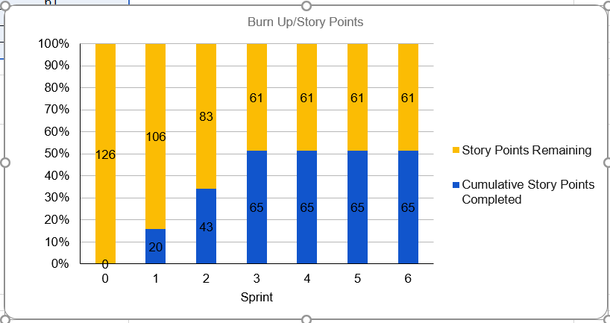
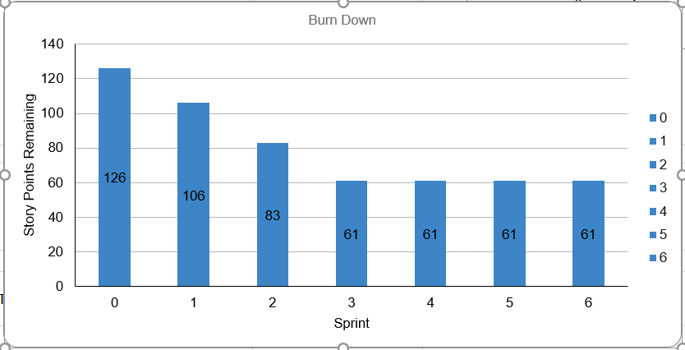
Sprints 1-3 Questions
What is your Velocity for the past 3 sprints?
[21.67 OR 22]
How do you know your Velocity is correct?
[ VELOCITY = Completed Story Pts( 65)/ Sprints(3)] 20 +23+22 (Story Pts) = 128 / 3 (# of sprints)
What would the BURN DOWN chart look like for Sprints 1-3?
[Place your chart to the right]
What would the BURN UP charts look like for Sprints 1-3?
[Place your chart to the right]
How many points do you think the Team should commit to for Sprint 4 and justify your answer?
[From 21 to 23. It is within the same ranges as prior sprints.]
Place Burn Up Chart for Sprint 3 Here

Slide 4
Agile Communication
Project
Sprint 4

Slide 5
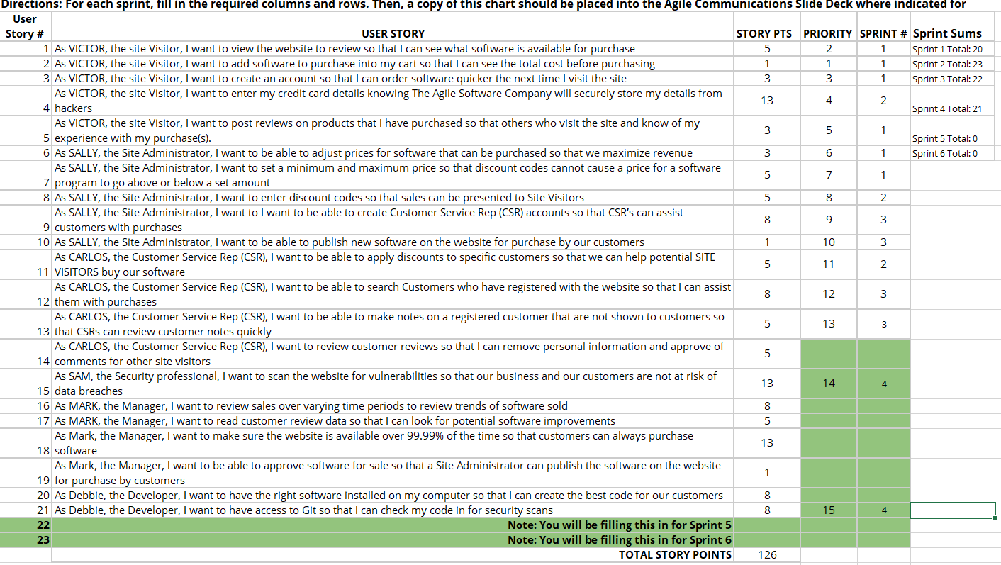
Place User Stories Table for Sprint 4 Here

Slide 6
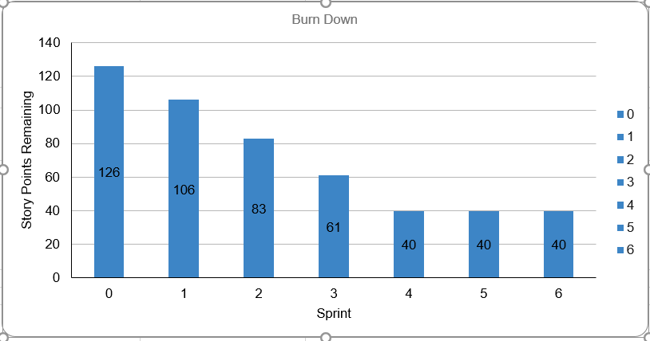
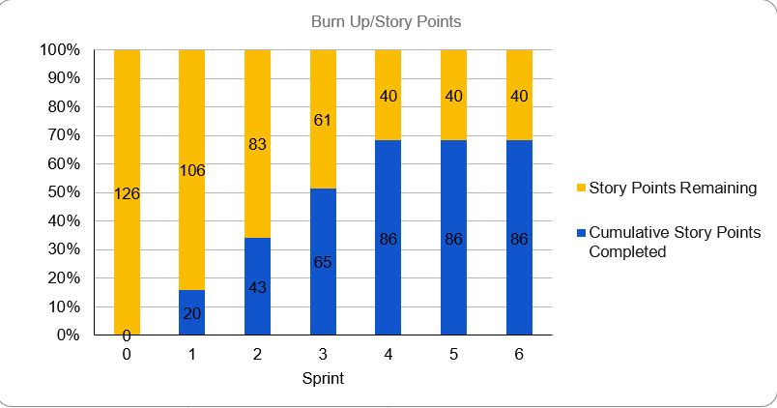
Sprint 4 Questions
What would the BURN DOWN chart look like for Sprints 1-4?
[Place your chart to the left]
What would the BURN UP charts look like for Sprints 1-4?
[Place your chart to the left]
How did the re-prioritization impact the Sprint 4 schedule?
[All activities related to the cyber security incident were the TOP priorities. Sam was set to 14 and Debbie’s security scanning was set to 15. Total of 21 user stories.]
What Theme or Name did you give to Sprint 4?
[INTRUSION_DETECTION : Hacker Halted.]
Place Burn Down Chart for Sprint 4 Here
Place Burn Up Chart for Sprint 4 Here

Slide 7
Udacians
Sprint 4 Name
“ INTRUSION_DETECION : Hacker_Halted! “
Place Sprint 4 Burn UP Chart Here
User Stories in Sprint 4
1. Story # 15 with 13 points
2. Story # 21 with 8 points
3. Story # xx with xx points
**All stories on sprint 4 were on Priority 1 (SAM (13) & Debbie ( 8)
Total Sprint 4 Points: 21
Place Sprint 4 Burn Down Chart Here
Narrative SAM, C.E.H., CISSP needs to have top priority{Code Red} , Debbie the < developer > also plays vital role
Results Security related incidents have been mitigated Learnings Emergency Priorities are given extremely high importance
Risks Security breaches are 1st thing that has to be avoided at all costs. Hence the entire sprint was dedicated to security issues.
SPRINT 4 DEMO of Working Product

Slide 8
Agile Communication
Project
Sprint 5

Slide 9
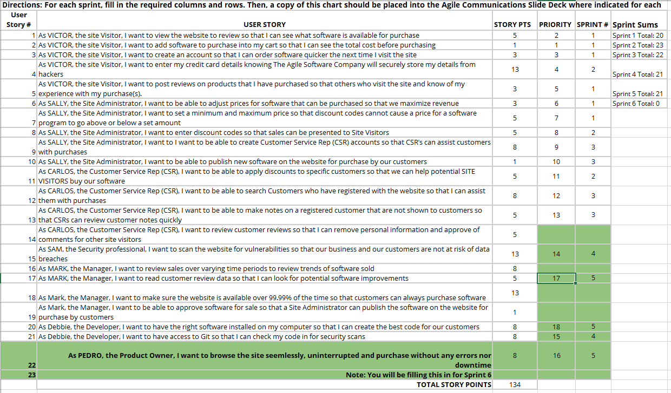
Place User Stories Table for Sprint 5 Here

Slide 10
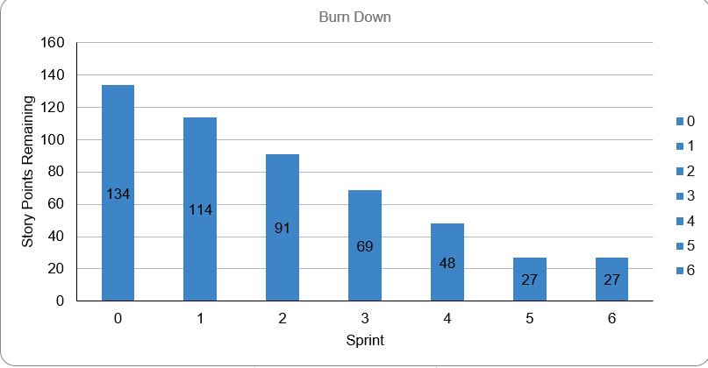
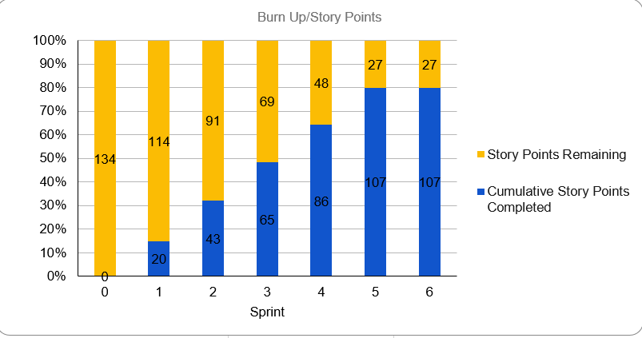
Sprint 5 Questions
What would the BURN DOWN chart look like for Sprints 1-5?
[Place your chart to the left]
What would the BURN UP charts look like for Sprints 1-5?
[Place your chart to the left]
How did the re-prioritization impact the Sprint 5 schedule?
[Secrutiy Incidents are top notch priroty. Prior to Sprint 4 there were 40 story points remaining. No we have 27 left. Our scheduled changes were put aside. And then, the issue of UX/CX arrived so we had to reprioritze again. ]
How confident are you in delivering all of the user stories by the end of Sprint 6? Justify your answer.
[It depends. As of now there are 27User_ Stories left. Unless something that has an ‘emergency status’ of a massive/global scale occurs, then we may finish them by 6th.]
Place Burn Down Chart for Sprint 5 Here
Place Burn Up Chart for Sprint 5 Here

Slide 11
Udacians
Sprint 5 Name
“UX & CX Rules “
Place Sprint 5 Burn UP Chart Here
User Stories in Sprint 5
1. Story # 22 with 8 points
2. Story # 17 with 5 points
3. Story # 20 with 8 points
Total Sprint 5 Points: 21
Place Sprint 5 Burn Down Chart Here
Narrative UX & CX are of utmost importance. Usablity testing is very vital
Results Corrections have been made by the coders & UX team
Learnings Sudden adjustments if justified should be made. High importance should be given to USABILITY issues
Risks Losing clients & having tons of bad reviews if this weren’t corrected
SPRINT 5 DEMO of Working Product

Slide 12
Agile Communication
Project
Sprint 6

Slide 13
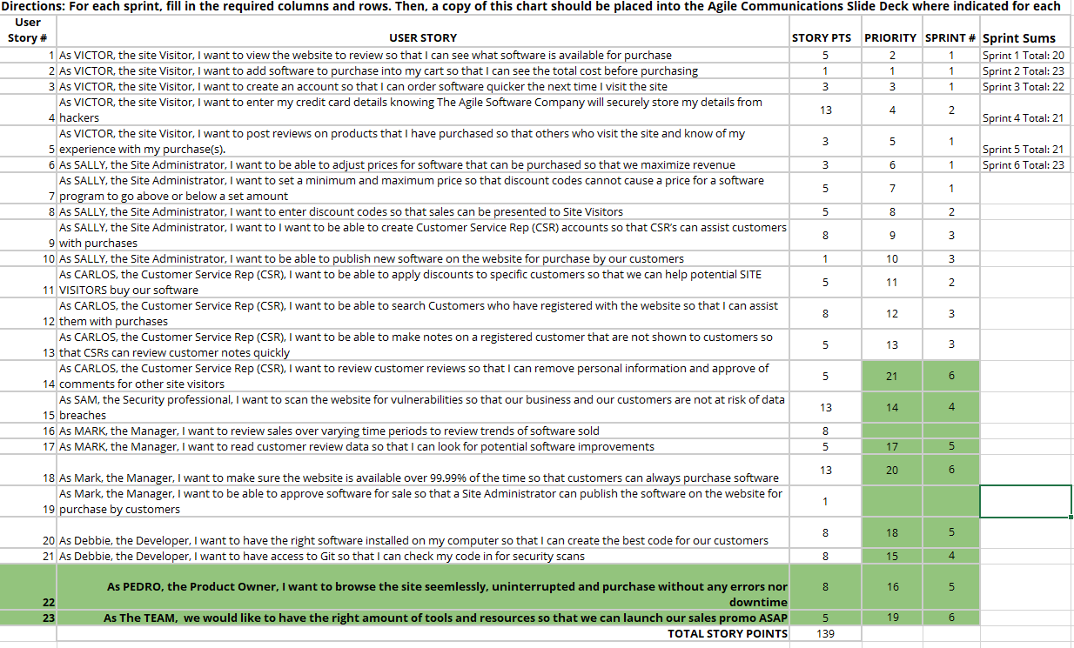
Place User Stories Table for Sprint 6 Here

Slide 14
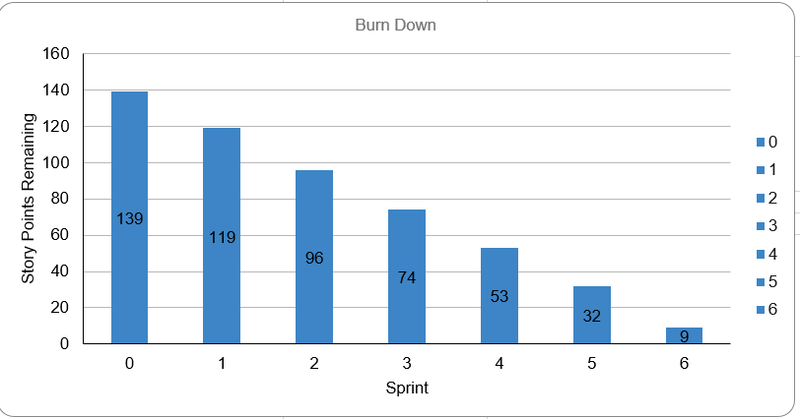
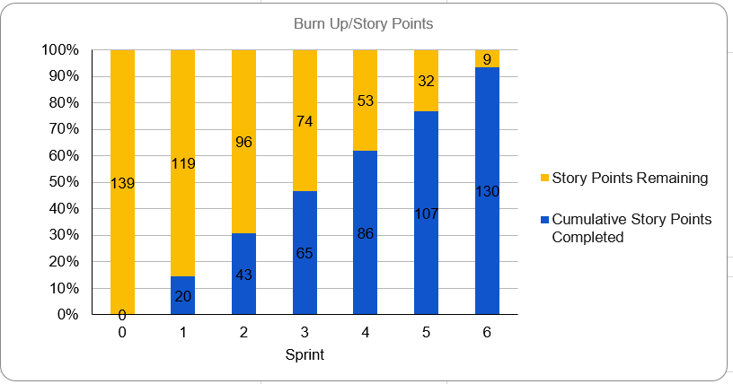
What would the BURN DOWN chart look like for Sprints 1-6?
[Place your chart to the left]
What would the BURN UP charts look like for Sprints 1-6?
[Place your chart to the left]
Was the Team able to complete all the work in the backlog or did you have to adjust what could be delivered? How would you tell this to Management and justify your answer.
[There was a slight delay due to the recent 3 major changes. The cyber security reprioritization had a huge impact. 1. Cyber Security Risk 2. UX/Usability Related upgrades 3. Global Pandemic that reuqires marketing & sales strategies.]
Place Burn Down Chart for Sprint 6 Here
Place Burn Up Chart for Sprint 6 Here

Slide 15
Udacians
Sprint 6 Name
“ Let’s Go B.O.G.O! “
Place Sprint 6 Burn UP Chart Here
User Stories in Sprint 6
1. Story # 14 with 5 points
2. Story # 18 with 13 points
3. Story # 23 with 5 points Total Sprint 6 Points: 23
Place Sprint 6 Burn Down Chart Here
Narrative Due to global pandemic there was a sudden need to sell some of the stocks & a sales /marketing strategy has to be implemented
Results The necessary tasks were done. It did have an effect of not finishing all user stories after this sprint.
Learnings COVID-19 was totally unexpected. It placed the entire team’s resources & priorities.
Risks This sprint affects the upcoming results since a pandemic was totally unexpected.
SPRINT 6 DEMO of Working Product

Slide 16
BVIR for Management Questions
Which charts would you want to include in the BVIR that Management would need and why?
Move the Orange boxes to the correct column below
[I have nothing to hide to management. Both charts would indicate that my team has missed 9 story points. We did have 105 cumulative story points comitted. As a ‘Udacity Certified’ Product Owner, Sprints 4 to 6 has ‘disrupted’ the flow that our team had during Sprints 1 to 3. Sprint 4 was focused on the needs & issues with SAM, our INFOSEC guy and Debbie, our developer. Sam definitely would need the help of a coder. Sprint 5 , Edith, which is also a stakeholder/customer, has some serious Usability issues. The issues she had was given priority 1 together with very similar user stories such as: ‘SALLY the side admin who wants to create CSR accounts, Victor the site visitor who wants to add software to purchase and last but not the leats, Debbie’s need to have the right software installed so she can deliver high value products to customers. In Sprint 6, COVID-19 just took a toll on everyone. It was totally unxecpted and our ENTIRE TEAM had to shift to ‘semi permanent’ remote in less than 48 hours. This itself, plus the logistical and ‘pyschological aspects’ of COVID slowed our team a bit. Then our B.O.G.O. promo has to be the main priority. We had to reprioritize everything and make them priority 1 so that we could move on to the next sprint.]
Included
Not included
Burn Down Charts
Committed vs. Delivered Chart
Burn Up Charts
Story Point Cost per Team

Slide 17
Creating the BVIR for Management
Questions to answer before you start the BVIR
What would tell Management if they want to know the details about actual stories?
[Select from the choices below]
"While I understand that you want to get into individual stories and know all the details, we would prefer that Management spends your valuable time guiding and influencing the Roadmap and direction of the project and leave the story delivery to the Teams you have empowered."
Absolutely, let's get into the details!
No, that is none of your business
Which of the above did you choose (1,2,3) and why?
[DEFINITELY I would choose Number 2! This is HANDS-DOWN my only respnse for now. As a Product Owner, I have NOTHING to hide. Sprints 4 to 6, especially 4 & 6 definitely took a toll on our performance. I also suggested that form Sprints 4 to 6 (which the entire team agreed), to make them all priorities because of the SUDDEN-EXTREME URGENCIES. I In this realistic situation, I can now say that Sprint 7 is not mandatory although it would help. We now have ZERO 9 user stories left .]

Slide 18
Creating the BVIR for Management
Questions to answer before you start the BVIR
Is it project considered a failure because backlog items still remain? Explain.
[From my perspective this could be taken in different contexts. We now have zero user stories left. Although I am torn between going for another sprint (7) or more likely focus on doing the other higher priorities. On the other hand, I can also STRONGLY ARGUE that the last 3 sprints, especially 4 and 6; as I have mentioned previously, definitely took it’s toll on out team. Sprint 4 was a probable SECURITY BREACH that could have been disastrous. As a P.O. , plus with my team’s backing, we ALL AGREED to prioritze user stories about SAM and DEBBIE. Debbie being a developer definitely needed her tools & software up and running so she could back up SAM in his/her cyber security resiliency efforts. In the end we managed with 0 user stories left. Sprint 6 , the global community took a strong hit! We had to suddenly switch to a fully operational remote team in a matter of 48 hours max. This was totally out of the blue. On top of this, we had to suddenly promote a ‘FLASH SALE B.O.G.O.’. And management wants it ASAP. So these 2 sprints by themselves have definitely taken a lot of toll on our team, hence we have 31 user stories left for Sprint 7. ]

Slide 19
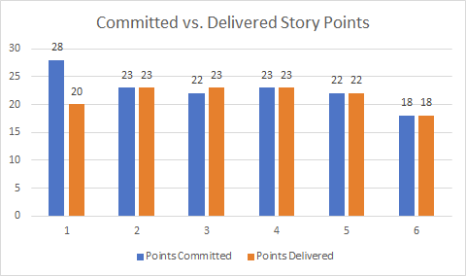
Creating the BVIR for Management
Instructions:
Start by creating your own BVIR. From the charts and sections below, please drag and drop items you would like to display to convey the story behind the MVP project
[Cut and paste items from this section and add them to the next slide. Remember to fill in information in the boxes where it is needed]
Chart showing cost per story point
Chart Comparing Sprint Velocity of Teams 1 vs Team 2

Slide 20
BVIR for Management
[** This is the outline for the BVIR I’ve used for management]
MVP VISION
Roadmap
Team Name

Slide 21
BVIR for Management
[]
Roadmap
MVP VISION To Be The Premiere E-Commerce Platform; Providing The Best Online Shopping Experience. No Downtimes. No Interruptions.
Udacians

Slide 22
BVIR for Management
[Now that you have created your BVIR for management, you need to create a video or written narrative explaining the MVP delivery status.
Use this slide to write your narrative or plan what you want to say in your video. ]
Include (at the minimum) the following:
Team Name - > UDACIANS
Vision -> To Be The Premiere E-Commerce Platform; Providing The Best Online Shopping Experience. No Downtimes. No Interruptions.
Sprint Burn Down Charts for Sprints 1-6 -> Already Included.
Sprint Burn Up Charts for Sprints 1-6 - > Already Included.
Project status (complete / incomplete) - > INCOMPLETE. 9 StorY points left. Reserved fully for Sprint 7.

Slide 23
Questions from Management (Using Videos would be great!)
Instructions:
Watch the videos in the classroom. (I’ve also created 4 videos as a response to each)
Record your videos or provide your answers below. Remember to justify your answer.
[Video # 1 Greetings Ms. CFO. First of all, I would totally agree that our product is totally FAR from perfect. It’s even FAR form excellent as of now. As we all know, sprints 4 to 6 have definitely impacted the entire team to such a high degree. Zero user stories left. ]
[Video # 2 Greetings Ms. CMO. It’s not a matter of deviating per se, based on the circumstances I really had no choice. As what I’ve mentioned to CFO, I had no choice due to Sprints 4 to 6. Especially 4 and 6, everything just got totally ‘bugged’ down. ]
[Video # 3 Mr. CEO, As a Product Owner, I (together with the entire team) had to respond to what we deem as extremely necessary. And no, workign 24/7 is by no means possible at all.]
[Video # 4 Oh yed indeed Mr. CTO. I’d highly recommend we go for Sprint 7 although it may not be that necessary. With 9 story points left, we’re good to go!]

